Slide 1
OA3103: Data Analysis
Exploratory Data Analysis (EDA) and Data Cleaning (Part II)

Slide 2
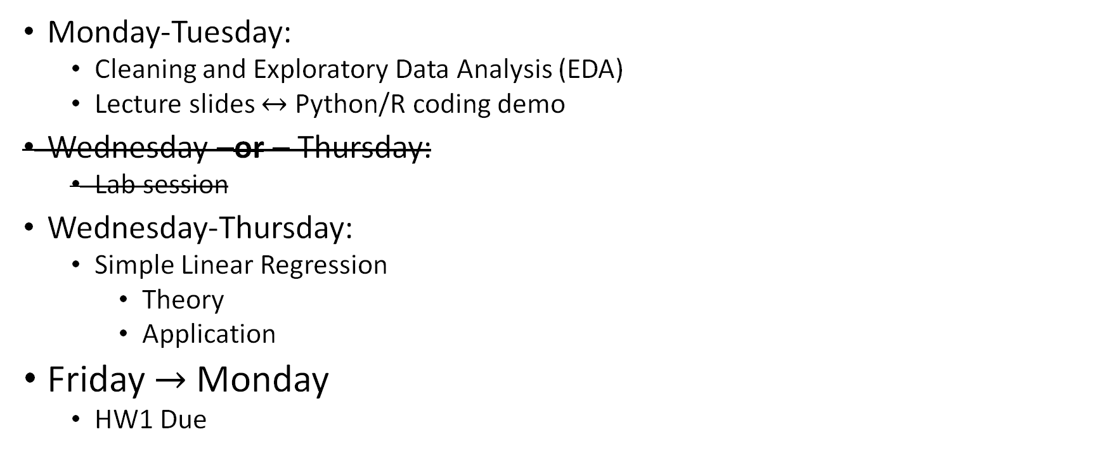
This Week’s Roadmap
Monday-Tuesday:
Cleaning and Exploratory Data Analysis (EDA)
Lecture slides $↔$ Python/R coding demo
Wednesday –or – Thursday:
Lab session
Wednesday-Thursday:
Simple Linear Regression
Theory
Application
Friday $→$ Monday
HW1 Due
Reminder: Quiz today

Slide 3
Visual EDA
So far we have focused on numbers to summarize the observations of a variable.
Visual EDA uses plots as a powerful tool to show the behavior of these observations.
We will tie the single-number summary statistics to this behavior.

Slide 4
Visual EDA - Categories
Categorize visual EDA into three types, based on how many variables we examine:
Univariate Data – behavior of a single variable (distributions)
ex:
Bivariate Data – behavior of the relationships between two variables
ex:
Multivariate Data –
Suggest interactions between two variables that affect a third
ex:
Patterns across many bivariate relationships at once
ex:

Slide 5
Visual EDA - Categories
Categorize visual EDA into three types, based on how many variables we examine:
Univariate Data – behavior of a single variable (distributions)
ex: ages, heights, service, communities
Bivariate Data – behavior of the relationships between two variables
ex: height vs weight
Multivariate Data –
Suggest interactions between two variables that affect a third
ex: effect of seniority and education on income
Patterns across many bivariate relationships at once
ex: Pairwise behaviors of height, weight, wingspan, and age

Slide 6
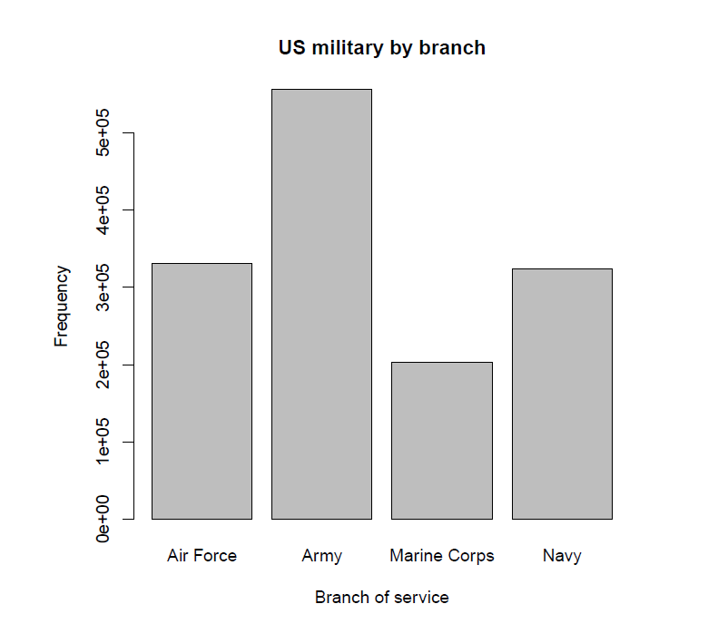
Univariate Data
Recommended plots per type of variable
Categorical data: Bar Plots
Numerical data: Histograms
Image source: EDA Example from the military dataset in the OIdata package (updated to the “openintro” package).

Slide 7
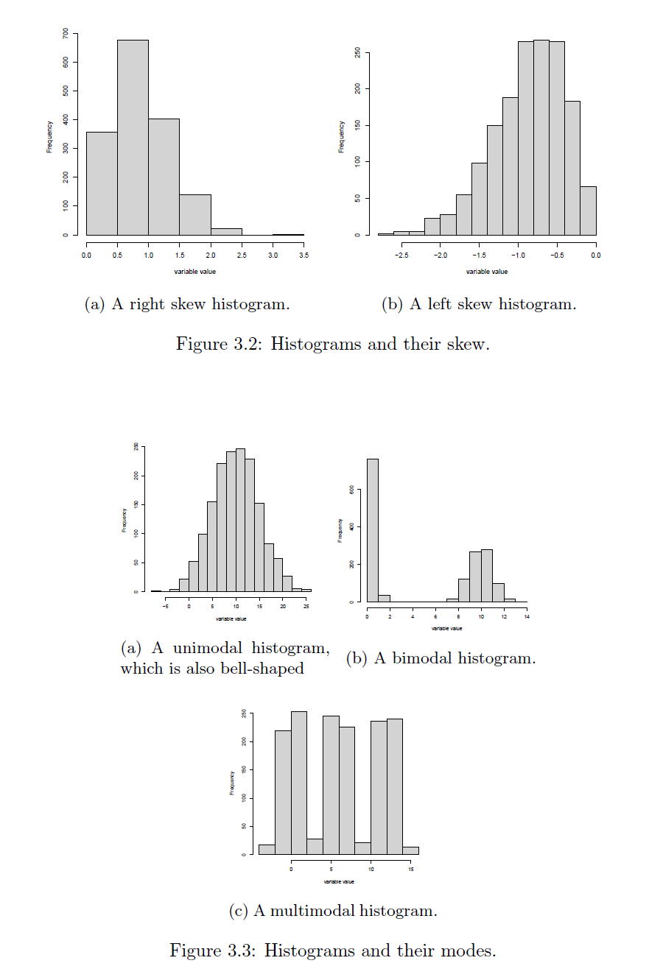
Histograms
Visually check:
Symmetry vs Skewness
Multimodality
Unimodal: single peak
Bimodal: two peaks
Multimodal: two or more peaks
Shape
Bell-shaped: Tells us what?
Image source: EDA Figures 3.2 and 3.3.

Slide 8
Applications of Standard Deviation
Empirical Rule:
If the histogram of a set of observations is bell-shaped, or approximately Gaussian (why would this happen?):
About 68% of observations lie within 1 standard deviation of the mean.
About 95% of observations lie within 2 standard deviations of the mean.
About 99.7% of the observations lie within 3 standard deviations of the mean.
Notes:
Bell curves show up for several reasons.
Sometimes it’s the Central Limit Theorem — many small additive effects.
- In physics, maximum entropy: if all we know is mean and variance, the most natural shape is the normal.
- Biology, symmetry and aggregation. The normal distribution is the ‘default’ shape of randomness.

Slide 9
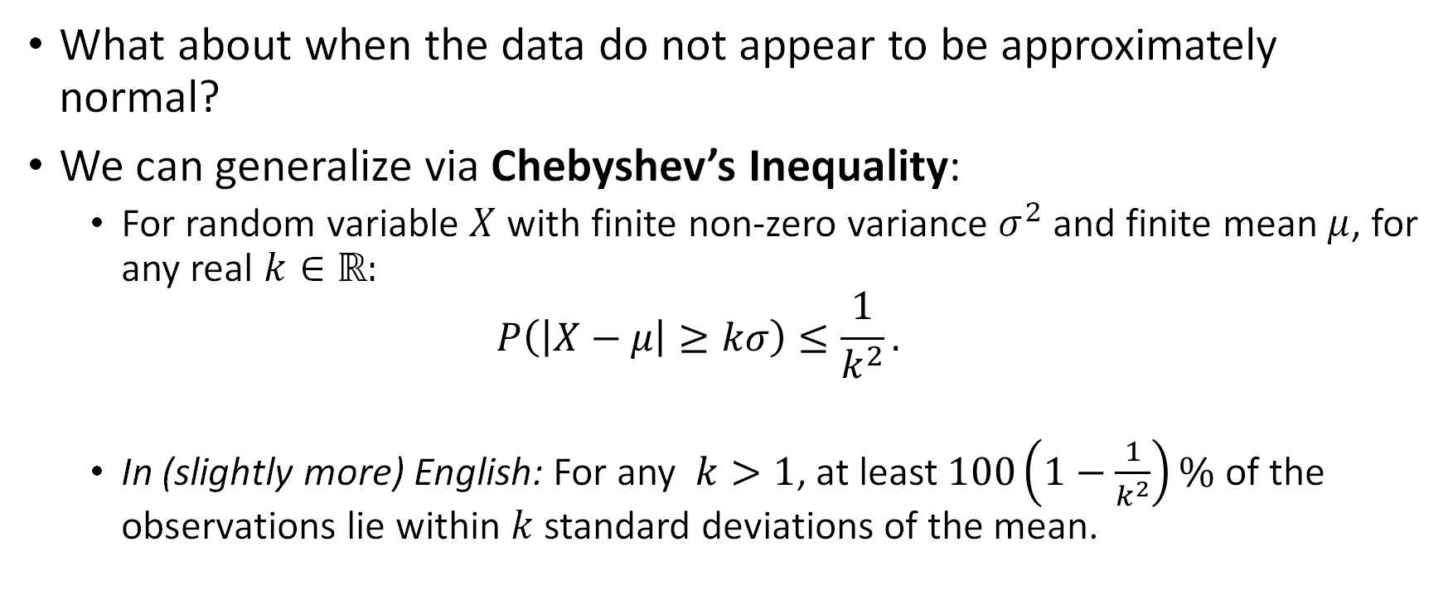
Applications of Standard Deviation
What about when the data do not appear to be approximately normal?
We can generalize via Chebyshev’s Inequality:
For random variable $X$ with finite non-zero variance $σ^{2}$ and finite mean $μ$, for any real $k∈ℝ:$
$$P\left(\left|X−μ\right|≥kσ\right)≤\frac{1}{k^{2}}.$$
In (slightly more) English: For any $k>1$, at least $100\left(1−\frac{1}{k^{2}}\right)\%$ of the observations lie within $k$ standard deviations of the mean.

Slide 10
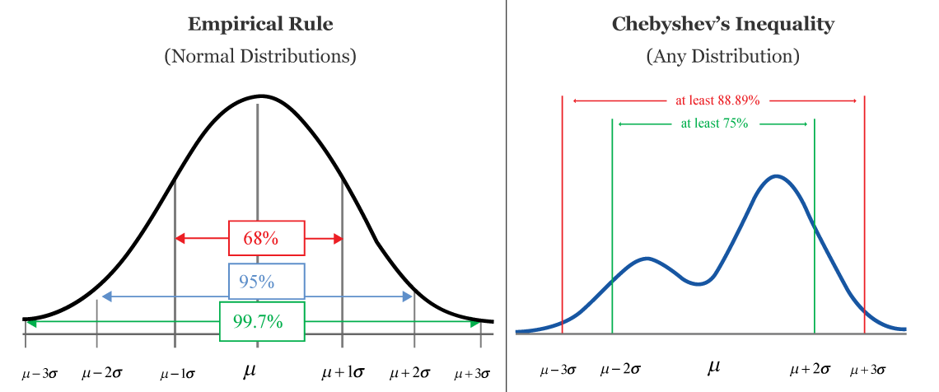
Applications of Standard Deviation
Empirical Rule gives us an approximate percentage of the data contained within a window of the mean.
Chebyshev gives a lower bound.
Image source: CalcWorkshop. Chebyshev’s Inequality. Retrieved from https://calcworkshop.com/joint-probability-distribution/chebyshev-inequality/

Slide 12
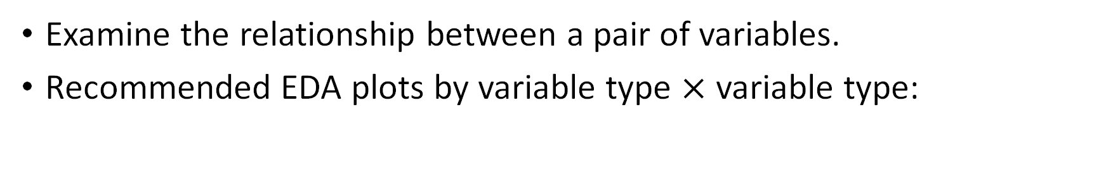
Bivariate Data
Examine the relationship between a pair of variables.
Recommended EDA plots by variable type $×$ variable type:
Data Types | Categorical / Ordinal | Numerical
Categorical / Ordinal | Grouped Bar Plot | Grouped Box plot
Numerical | Grouped Box Plot | Scatter Plot

Slide 13
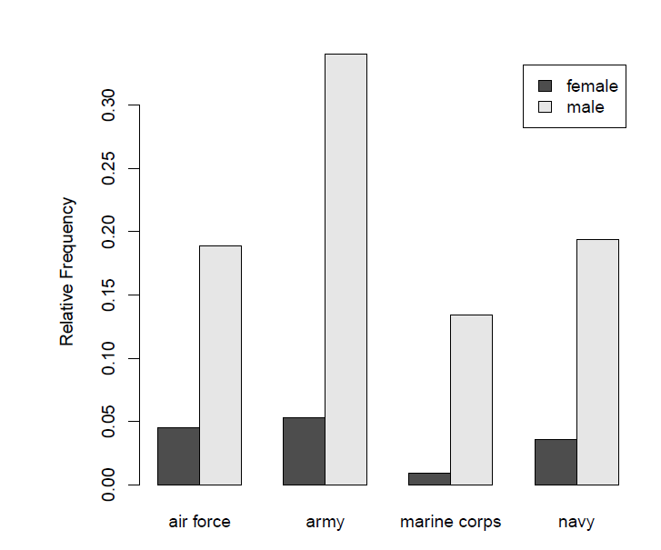
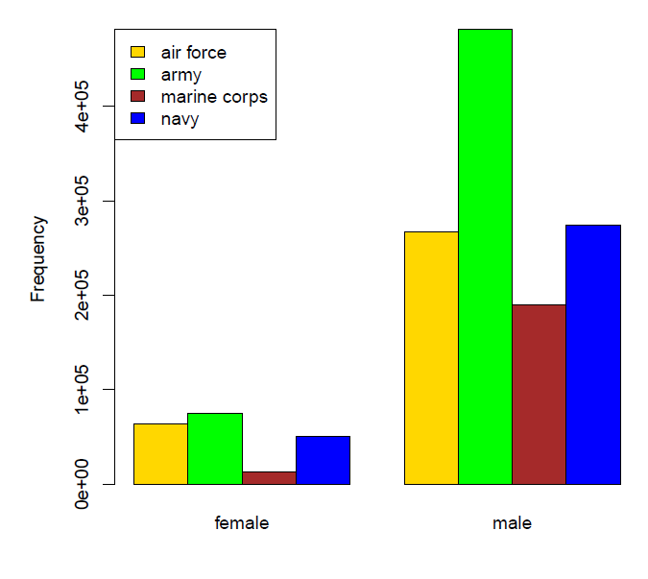

Grouped Bar Plots
Categorical / Ordinal $×$ Categorical / Ordinal
Image source: EDA Example from the military dataset in the OIdata package (updated to the “openintro” package).

Slide 14
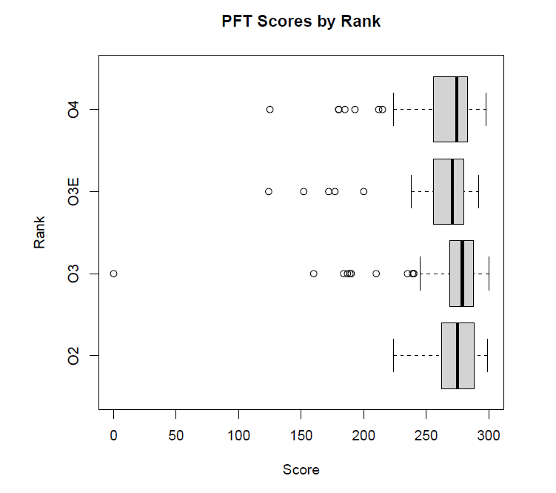
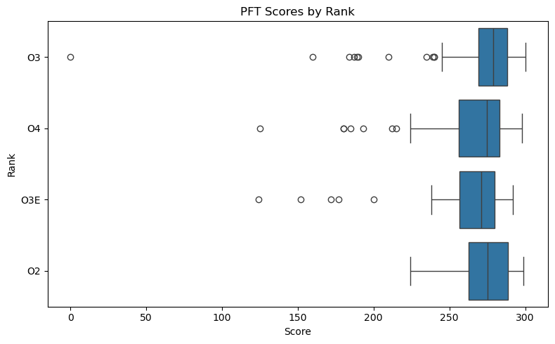

Grouped box plot
Categorical / Ordinal $×$ Numerical
R:
boxplot(pft_data$score ~ pft_data$rank, + horizontal=T, xlab=“Score”, ylab=“Rank”, + main=“PFT Scores by Rank”)
Python:
import seaborn as sns
import matplotlib.pyplot as plt
plt.figure(figsize=(8, 5))
sns.boxplot(
data=pft_data,
x="score", # horizontal axis
y="rank", # grouping variable
orient="h" # horizontal orientation
)
plt.xlabel("Score")
plt.ylabel("Rank")
plt.title("PFT Scores by Rank")
plt.tight_layout()
plt.show()
Image source: R (top) and Python/Seaborn (bottom) plots from the pft.csv dataset.

Slide 15
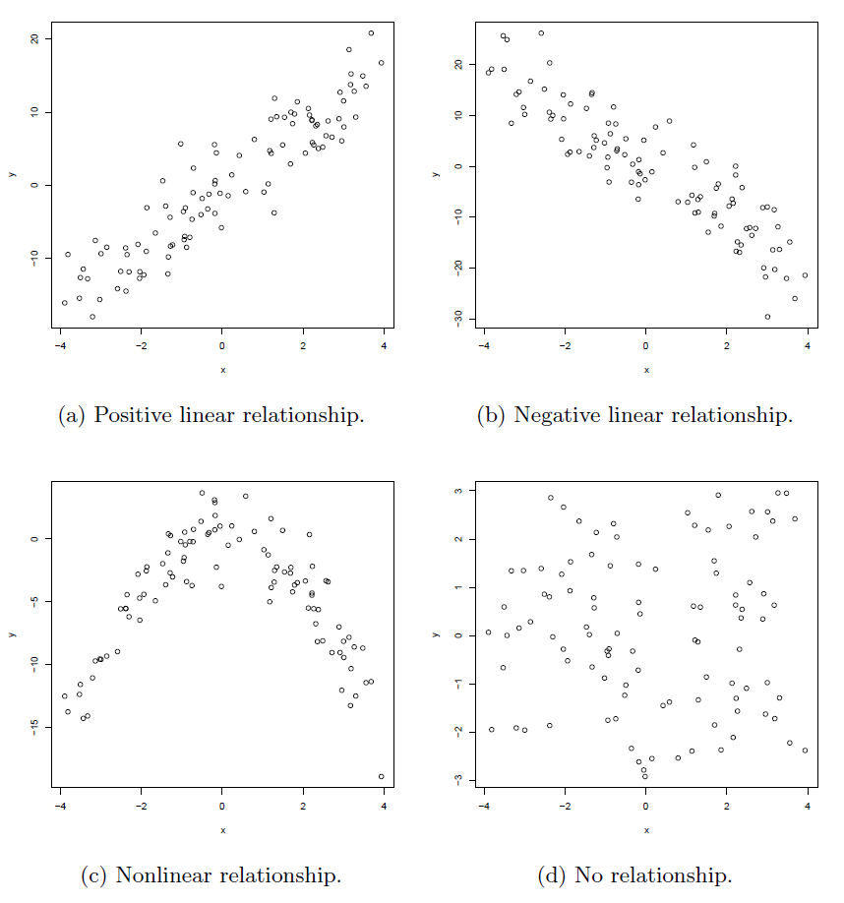

Scatterplots
Numerical $×$ Numerical
Image source: EDA Figure 3.8.

Slide 17
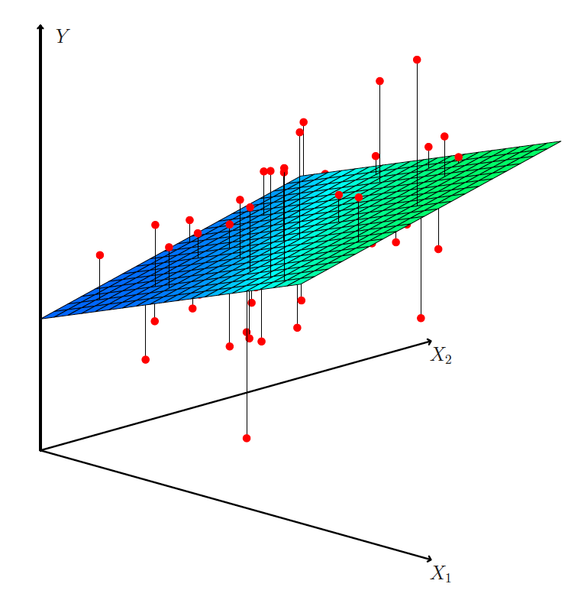
Multivariate Data
3d scatterplots
Scatterplot matrices
Correlation Heatmaps
Image source: ISLP Figure 3.4

Slide 18

Scatterplot matrices $→$ Correlation heatmaps
Not truly “multivariate”
Behavior of many variables together, often summarized through collections of pairwise relationships.
As the number of variables grows, pairwise plots become visually dense.
Heatmaps can summarize the same information more efficiently.

Slide 19
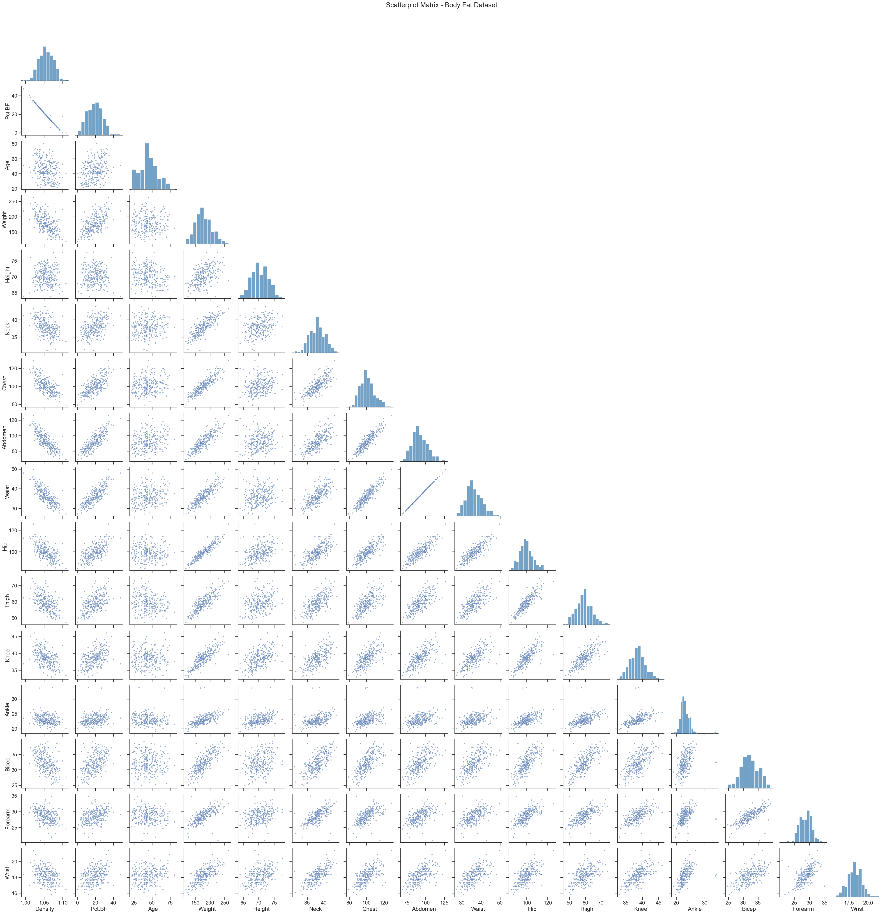
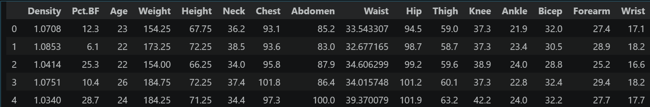
Scatterplot Matrix
Python:
head(body_fat)
16 numerical variables
Why are the diagonal entries histograms?

Slide 20
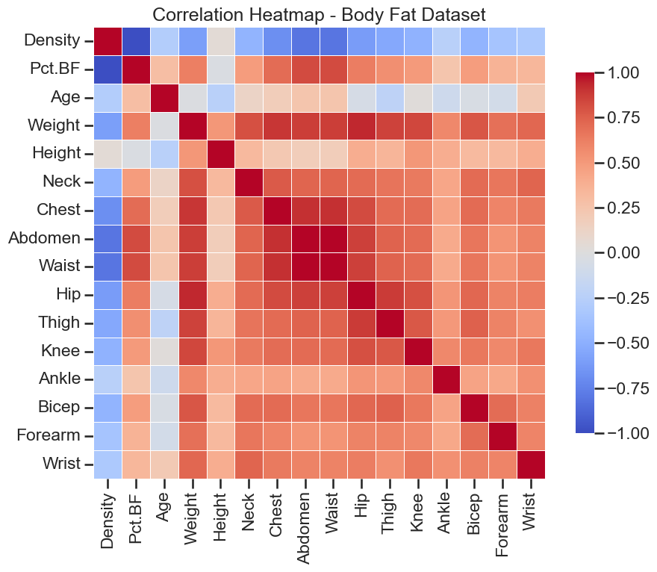
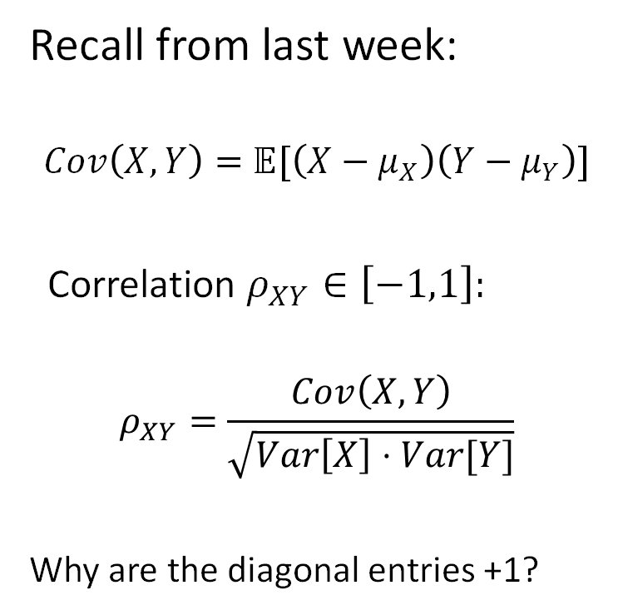
Correlation Heatmap
Recall from last week:
$$Cov\left(X,Y\right)=𝔼[\left(X−μ_{X}\right)\left(Y−μ_{Y}\right)]$$
Correlation $ρ_{XY}∈\left[−1,1\right]:$
$$ρ_{XY}=\frac{Cov\left(X,Y\right)}{\sqrt{Var\left[X\right]⋅Var[Y]}}$$
Why are the diagonal entries +1?

Slide 22
Back to Python/R
With the pft.csv data:
Build a histogram of the pft scores
Overlay the mean, median, and standard deviation lines
Verify the empirical rules and/or Chebyshev’s rule
Create a grouped boxplot of the score and gender variables.
Using the pima dataset from the faraway package:
Run a quick cleaning of the data
Zeros as missing: “triceps”, “insulin”, “bmi”
Create a correlation heatmap
(Time permitting) Save the clean pima data as a csv and create a pairplot and correlation heatmap in Python using seaborn

